Slide 1



WATER OVERFLOW SENSOR
AND
COLOUR SENSOR DETECTOR
DEPARTMENT OF ELECTRONICS AND COMMUNICATION ENGINEERING
22GCL12 – FOUNDATION LAB – Electrical, IoT and Web
(Internet of Things)
PRESENTED BY
25AUR001-ABIJITH .K.A
25AUR002-ASWIN .V
25AUR003-DEEPESH .P.S
25AUR004-DEEPIHAA .S
DATE: 12.11.2025
1

Slide 2
OBJECTIVE
The main objective of this project is to design and develop an IoT-based color detection system using a color sensor that can accurately identify and differentiate colors, and transmit the detected data to an online platform for real-time monitoring, analysis, and automation applications.
To design a PCB-based water overflow sensor that detects water levels accurately and prevents overflow automatically.
2

Slide 3
HARDWARE AND SOFTWARE REQUIREMENTS
Hardware Used:
TCS3200 colour sensor, NodeMCU/Aurdino , Wi-Fi module, power supply, jumper wires, breadboard, and display (optional).
Software Used:
Arduino , dashboard, and Embedded C programming.
3

Slide 4
BLOCK DIAGRAM
TCS3200 Color Sensor
POWER SUPPLY
ESP-32
ARDIUNO CLOUD
SERIAL MONITOR
IoT Platform & Dashboard
4

Slide 5
SERIAL MONITOR OUTPUT
TCS3200 Colour Sensor Initialized...
Connecting to Wi-Fi...
Wi-Fi Connected!
Sending data to IoT Platform...
Red: 125 Green: 98 Blue: 110
Detected Color: RED
-------------------------
Red: 78 Green: 120 Blue: 65
Detected Color: GREEN
-------------------------
Red: 90 Green: 95 Blue: 180
Detected Color: BLUE
-------------------------
Data sent to ThingSpeak successfully!
5

Slide 6
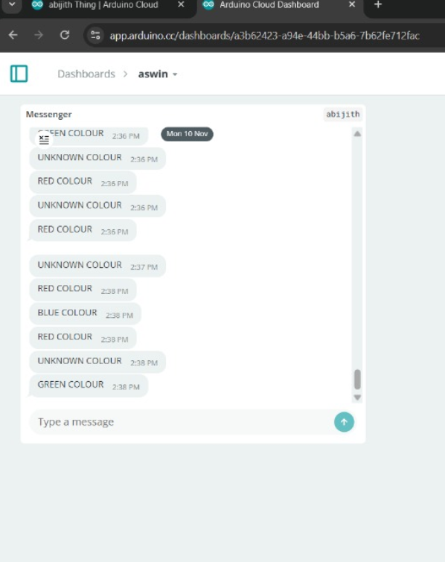
DASHBOARD
6

Slide 7
CONCLUSION
The IoT Colour Sensor Detection project successfully detects and identifies colors using the TCS3200 sensor and sends the data to an IoT platform for real-time monitoring. This system demonstrates how IoT and sensor technology can be combined for automation, quality control, and smart applications in industries and daily life.
The RCB Water Overflow Sensor effectively detects and prevents water overflow by continuously monitoring the water level in tanks or reservoirs. This system ensures efficient water usage, reduces wastage, and protects electrical components from damage. It offers a simple, low-cost, and reliable solution for both domestic and industrial water management.
7

Slide 8
THANK YOU

